Slide 1
SAP EWM EXTENDED WAREHOUSE MANAGEMENT TRAINING
AnubhavTrainings.com
www.anubhavtrainings.com

Slide 2

SAP EWM TRAINING
BY:-
Mr. Bijoy
www.anubhavtrainings.com
Notes:
https://unsplash.com/photos/uXB-7la5vqA

Slide 3
Internal Processes & Work center
Internal Processes - Product WT, HU WT for Adhoc movements, Posting changes
Work Center configurations
WT creation using Warehouse monitor

Slide 4
Ewm Internal Transfers And Work Center
Ad Hoc Movement
Use
Ad hoc movements are unplanned goods movements that you create manually within a warehouse. This means that the decision to make an ad hoc movement is not controlled by the system. Instead, it is triggered manually. Ad hoc movements do not have a preceding document. An ad hoc movement may be necessary for the following reasons:
The wrong product is located in the storage bin.
You have to take the product to another storage bin due to damage, for example for a quality inspection.
You want to take a product to the appropriate storage bin for scrapping.
You have to empty an aisle or storage bin for safety reasons.
You want to perform unplanned rearrangement movements.
You have to clear away stock lying around in the warehouse.

Slide 5
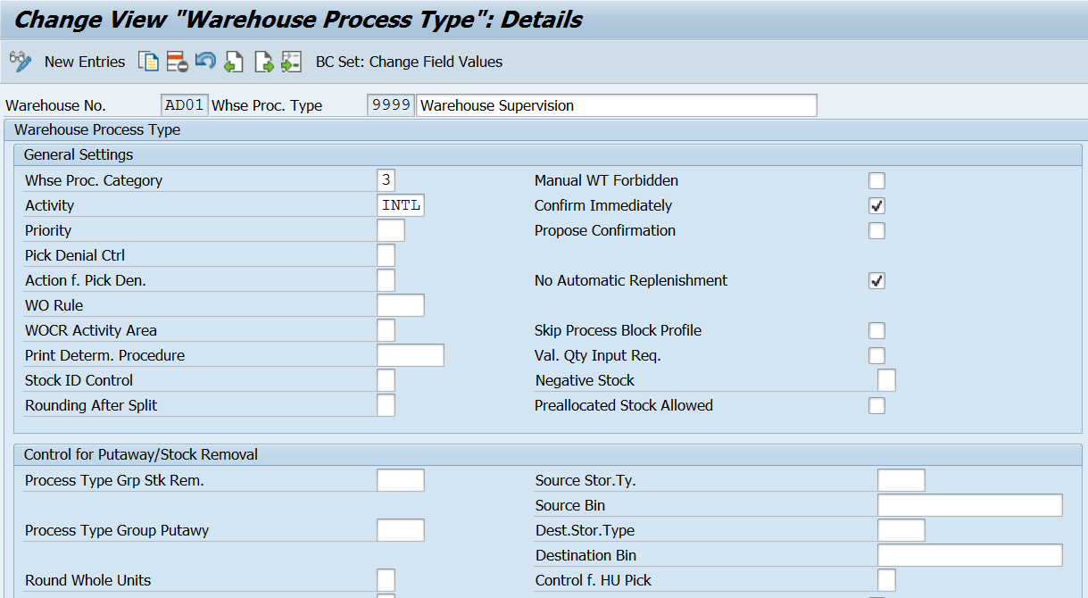
Internal Stock Transfer –
Creating Warehouse task for Product: /SCWM/ADPROD
Creating Warehouse task for HU : /SCWM/ADHU
Creating Posting Change - /SCWM/POST (Warehouse Process type – 4010)
Warehouse Process type 9999 (for Internal transfer)

Slide 6
Work Center Configurations
Define work center layout
Define storage type for work center (storage role = e)
Define storage section
Create bin for your work center (master data)
Define work center
Assign your storage bin to your work center - /scwm/tworkst (master data)
Transaction code: /SCWM/PACK

Slide 7
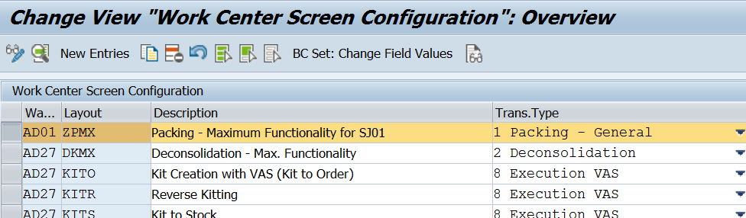
Define Work Center Layout
EWM > Master data > Work Center > Specify Work Center Layout
Create the various layouts in order to adapt the interface to the required work processes for a work center. Specify which functions are available, and which tab pages should be displayed.
Example - In the work center, the tab page for displaying open warehouse tasks is not required. You can use a layout to hide this tab page.

Slide 8
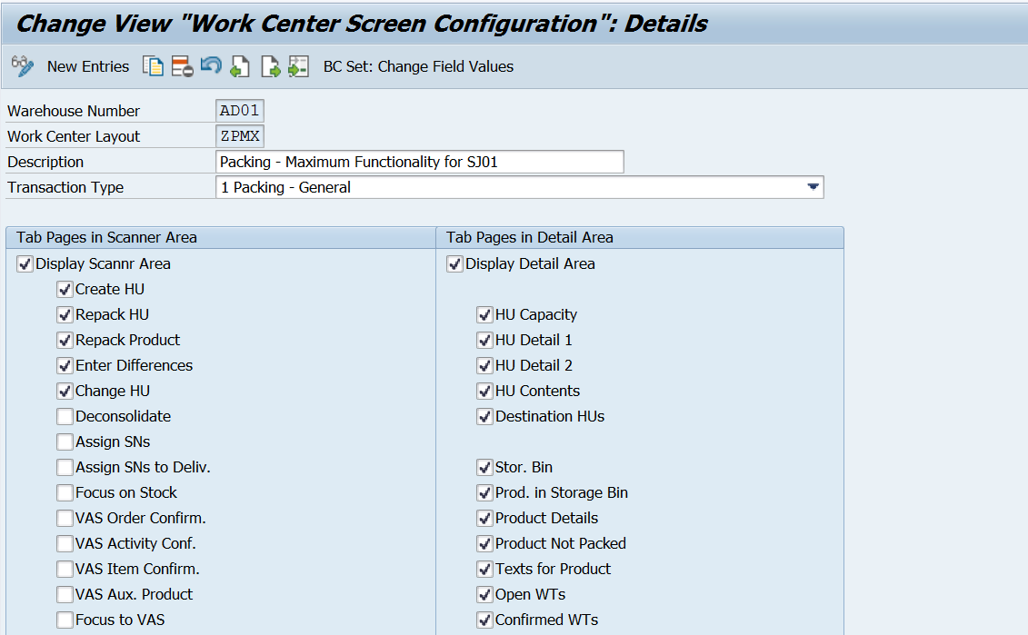

Slide 9
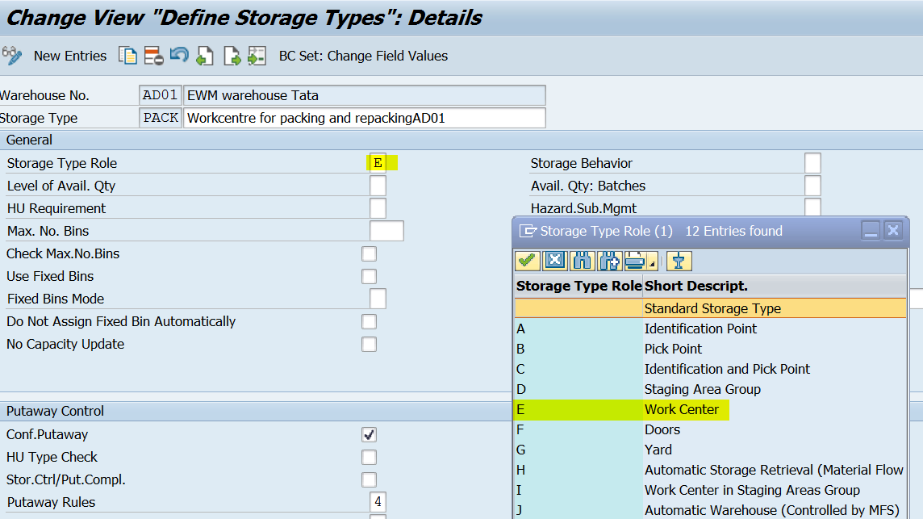
Define storage type for work center (Storage role = E)

Slide 10
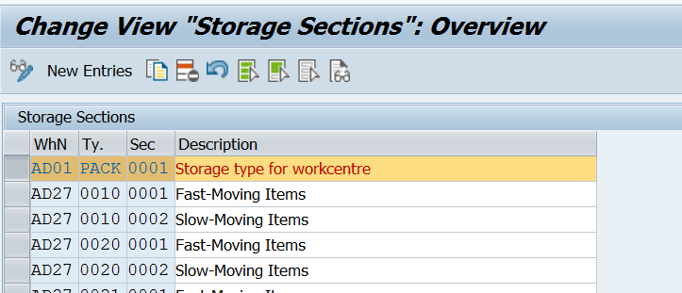
Define storage section

Slide 11
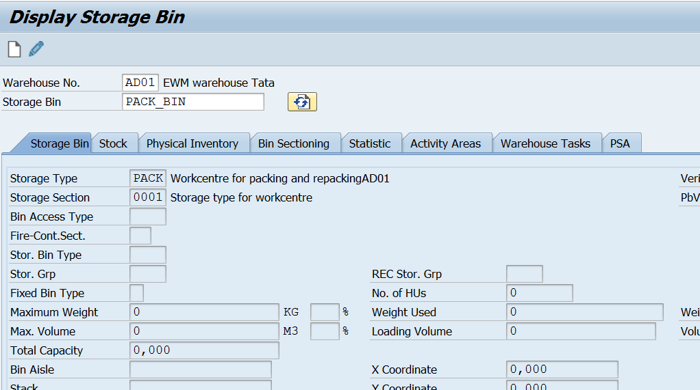
Create bin for your work center (Master data)
www.anubhavtrainings.com

Slide 12
Define work center
A work center in a Warehouse is assigned to a storage type and a physical unit to perform packing, deconsolidation or weighing activities. Storage type assigned to a work center has a role of the work center, pick point or pick point and identification. You can also configure more than one work center in a storage type.
A Work Center can be used for the following processes −
Packing
Deconsolidation
Counting
Quality check
www.anubhavtrainings.com

Slide 13
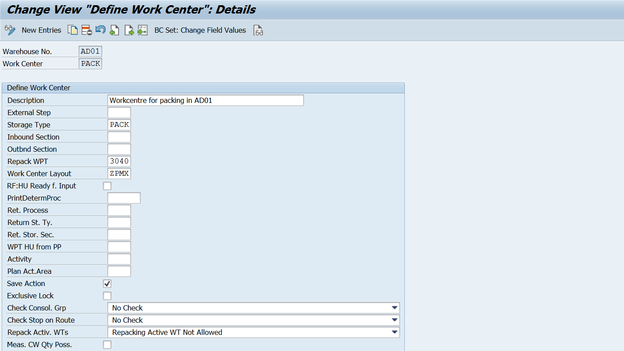
EWM > Master data > Work Center > Define Work Center

Slide 14
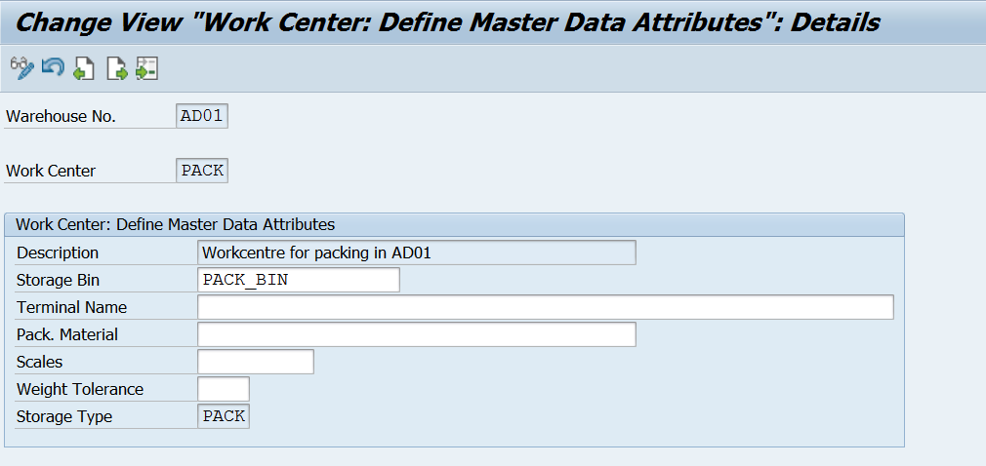
Assign your storage bin to your work center - /SCWM/TWORKST (Master data)
www.anubhavtrainings.com

Slide 15
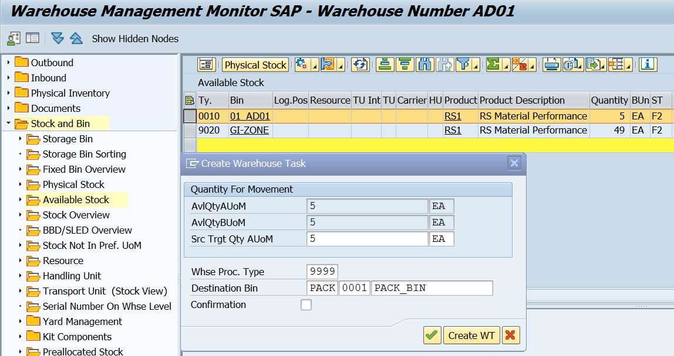
Test Scenario –
1. Create a Warehouse task for moving stock to PACK St type

Slide 16
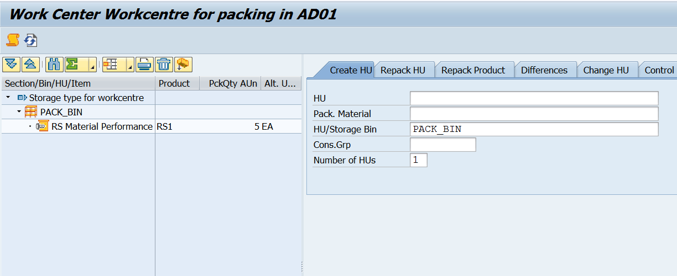
2. Go to tcode /scwm/pack

Slide 17
3. Create HUs for Repacking

Slide 18
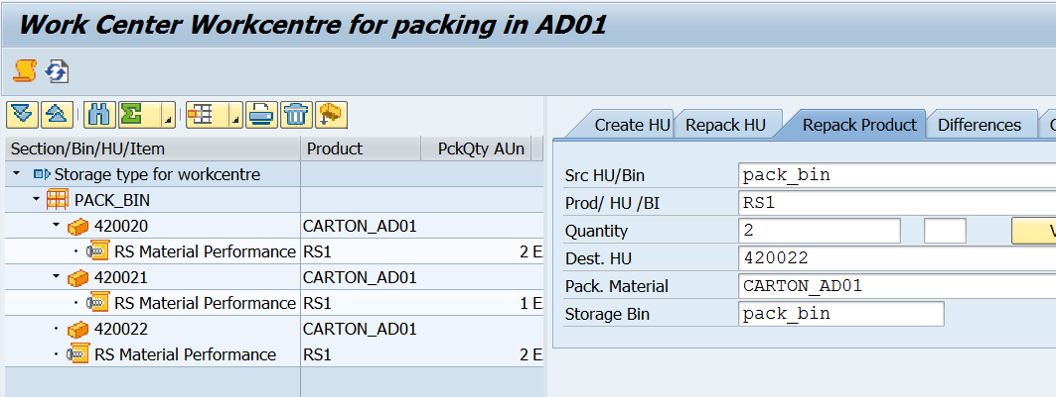
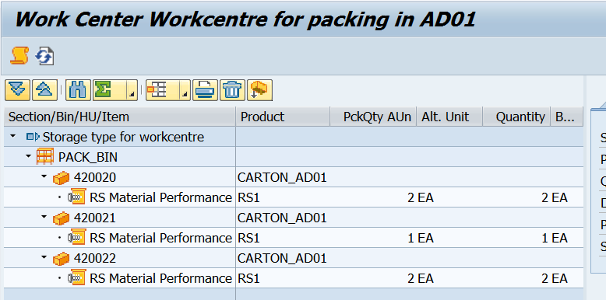
4. Repack the Product

Slide 19
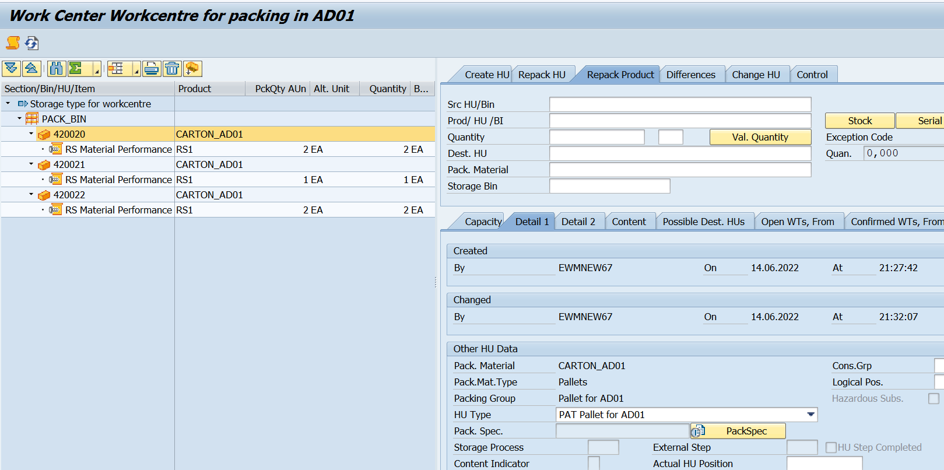
Double Click on HU Number (System will show details in following tabs which has been configured in Work center layout)
www.anubhavtrainings.com

Slide 20
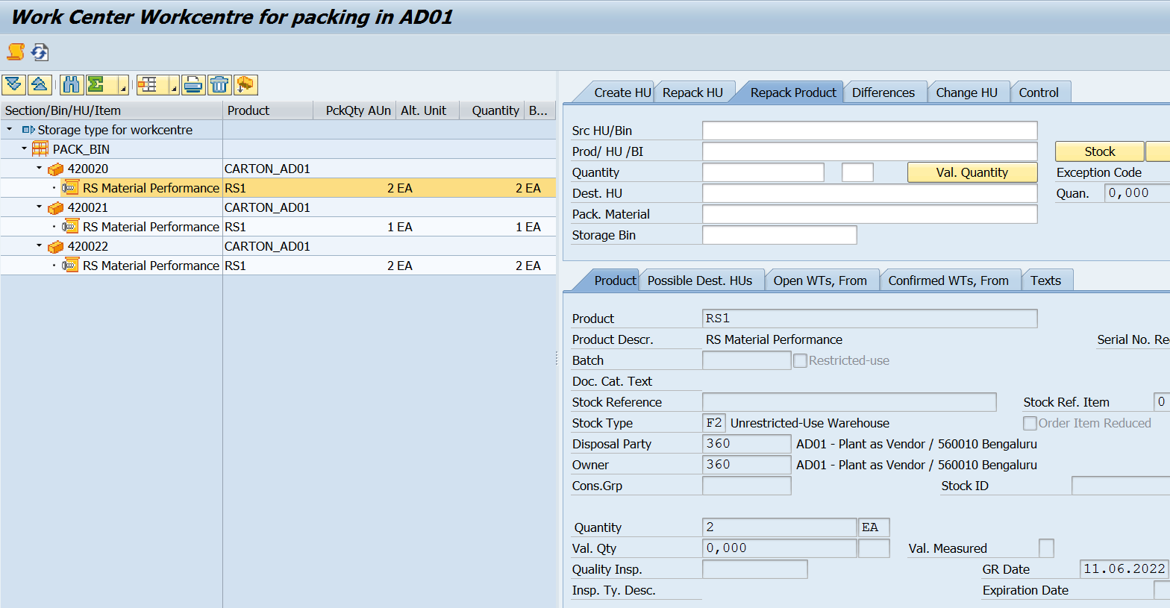
www.anubhavtrainings.com

Slide 21
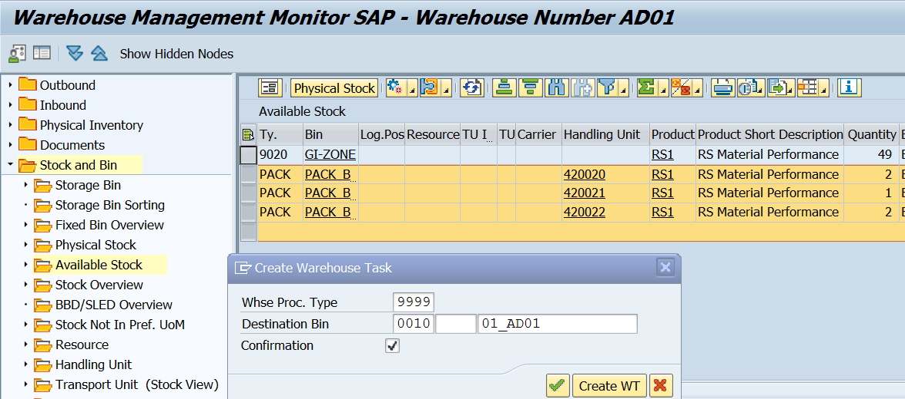
Move this stock from St type PACK to destination storage type-bin

Slide 22
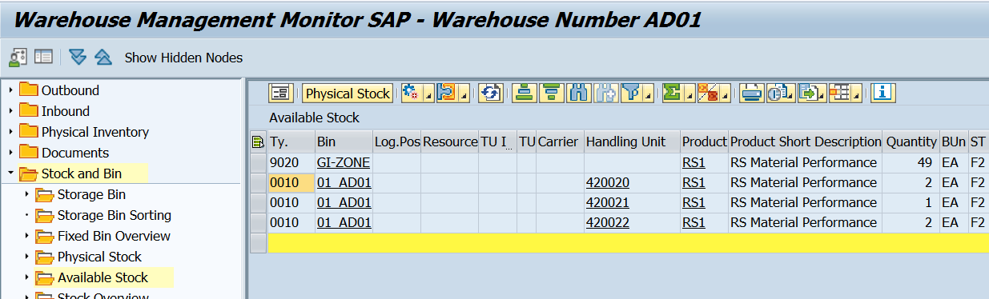

Slide 23


End of Session
www.anubhavtrainings.com

Slide 24

FEEL FREE TO ASK QUESTIONS

Slide 25

Feedback

Slide 26
THANK
YOU

Slide 27




More from AnubhavTrainings.com

Slide 28






We’re committed to empower you to be
#FutureReady
through powerful training solutions.
We build the workforce of the future.
250+
Corporate Clients
30,000+
Learners Trained
25000+
Learners Placed
FREE WEBINARS
Sign up for free webinars with industry experts every fortnight!
Enroll Now!

Slide 29
FREE WEBINARS
Sign up for free webinars with industry experts every fortnight!
Contact us today!
www.anubhavtrainings.com

